Slide 1
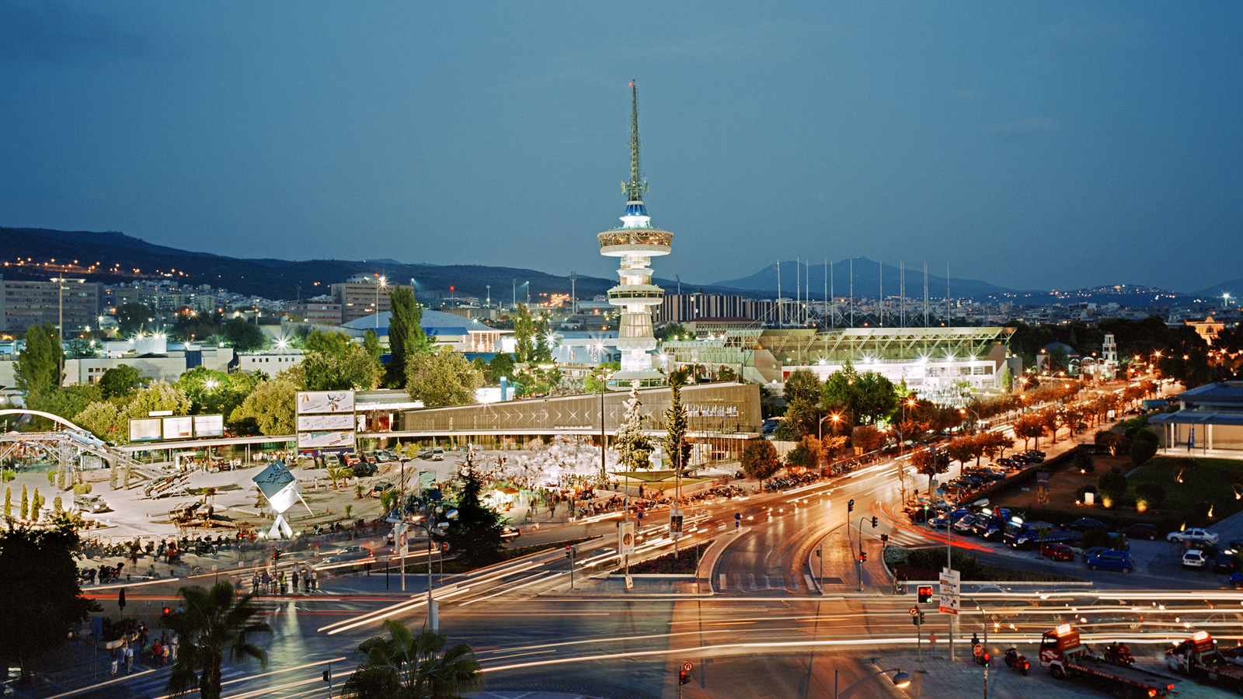

Welcome to Thessaloniki!

Slide 2
Vicky Dalkrani
Director of the Exhibition Research Institute
R & D Manager / Thessaloniki International Fair – HELEXPO SA
Degree in English Language & Literature / Aristotle University of Thessaloniki
M.B.A. / University of Macedonia
C.E.M. (Certified Exhibition Manager)
Degree in Translation
Multilingual
11 years of work experience in various sectors (textiles, wine, food, steel, services)
17 years of experience in the exhibition industry

Slide 3

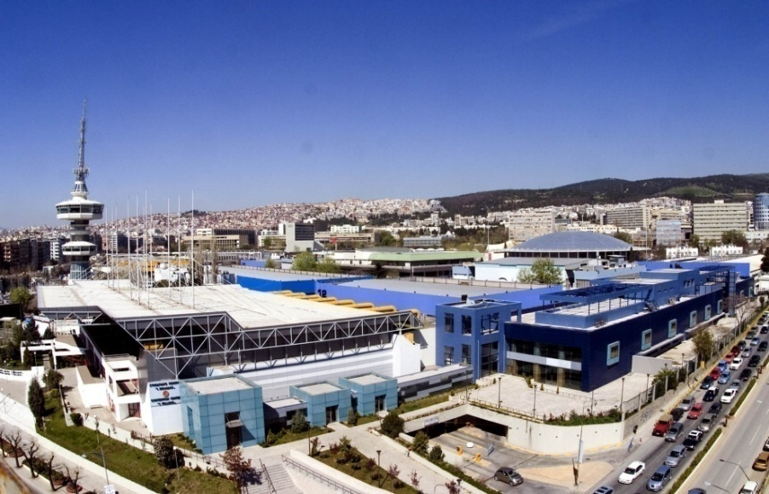
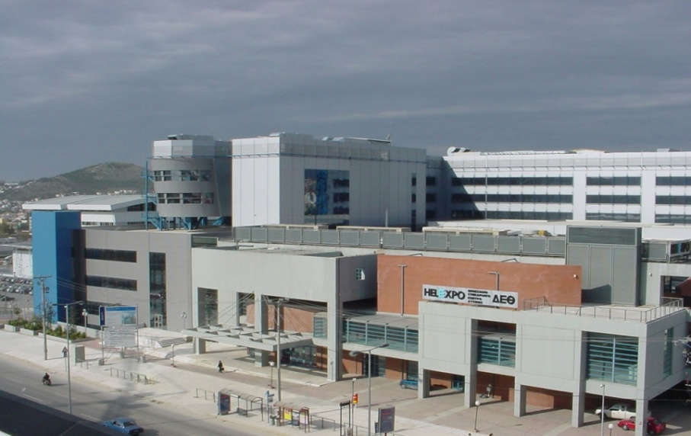
Thessaloniki International Fair
Introducing the company !
TIF - HELEXPO SA is the national exhibition & conference organizer in Greece and the owner of two exhibition and conference centers, one in Thessaloniki and one in Athens.
Venue Management IECT (Thessaloniki) 180.000 sq.m.
Venue Management IECA (Athens) 21.500 sq.m

Slide 4
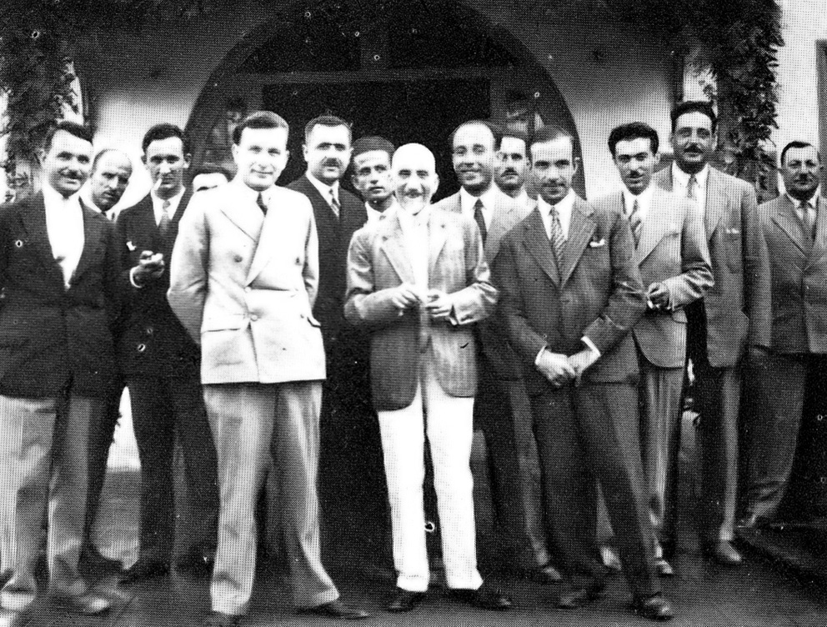

An innovative idea came
to light …
Trade International Fair!
The inventor
The idea of the first Thessaloniki International Trade Fair (TIF) was born in 1925. The father of the event was Nikolaos Germanos, member of the Greek Parliament, a scientist and politician from Chalkidiki who filed a petition to the Ministry of National Economy at that time requesting the permission to organize the first international trade fair in the country.

Slide 5

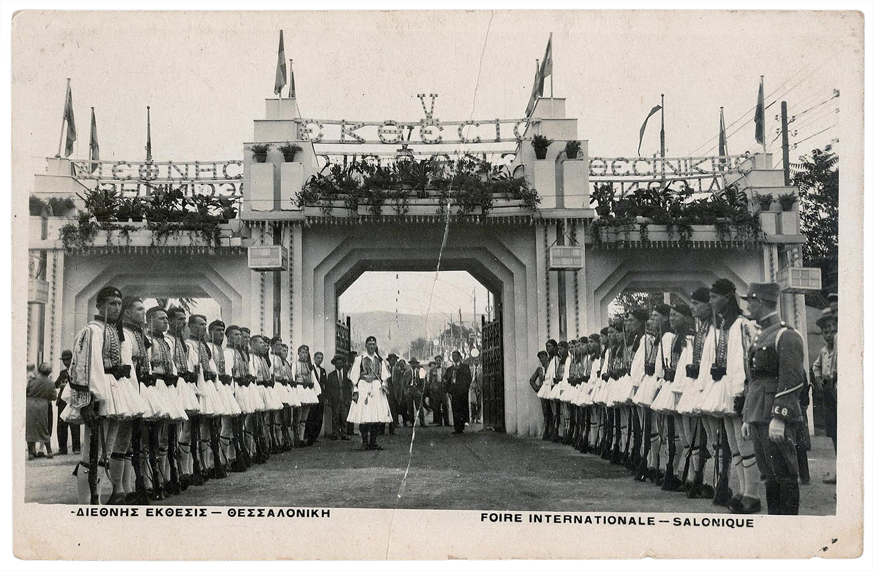
The first Trade International Fair was inaugurated on October 3rd 1926, thus marking a new important chapter for
the region’s economy.

Slide 6
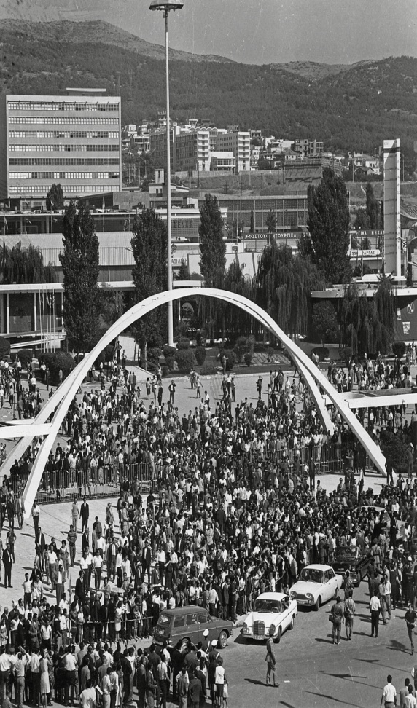
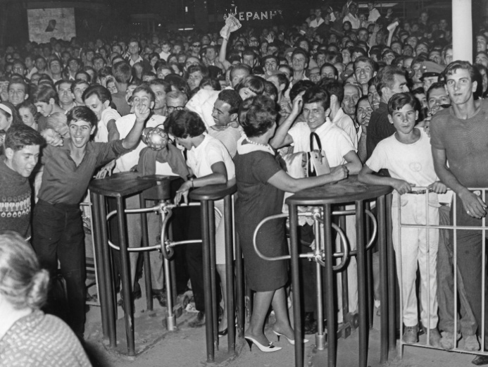
NOWDAYS TIF-HELEXPO
IN NUMBERS….
During the last year, trade fairs organized by the company (more than 20 own exhibition brands) attracted:
more than 3.500 exhibitors
around 1.000.000 visitors
more than 40.000 congress / conference participants
So, let’s start talking business … →

Slide 7
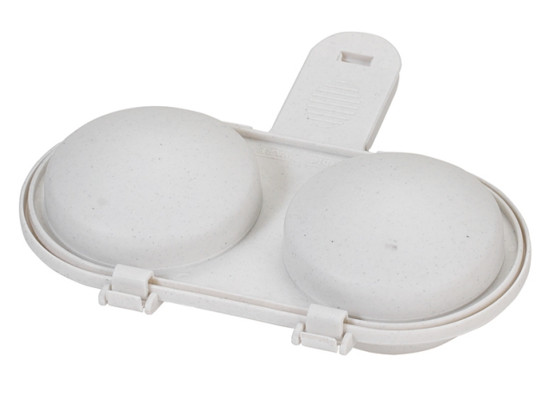
What is this ?

Slide 8
And the answer is …
uovo
egg
ou
yumurta
αυγό
jaje
It’s a Microwave
egg maker!!!
And the most important question is :
Would you buy one?

Slide 9

Most people would statistically reply:
Now let’s think more carefully:
To boil an egg you need at least 6-8 minutes
And to fry an egg you need a frying pan, oil, an electric oven and the capacity to turn it upside down.
Then you need to clean all the oil on and around the oven and wash the pan well.

Slide 10
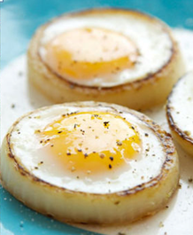

It’s delicious and easily cooked in the microwave !
Now look at this …
2 minutes – great taste – no oil around – no cleaning
Now… would you reconsider buying it?

Slide 11
Brainstorming
Let’s take a few minutes
to think : we want to promote / sell our microwave egg maker. How can someone get to know our idea, our new product or our company?

Slide 12

Don’t forget good partners, hard work and some … luck.
Here is what you do, step by step
Find the market gap
Create an Innovative / interesting product
Use the Marketing Mix to promote it
Central position in the Marketing Mix:
Exhibitions
Branding – promotion - networking!
Sales – Survival even in times of crisis

Slide 13
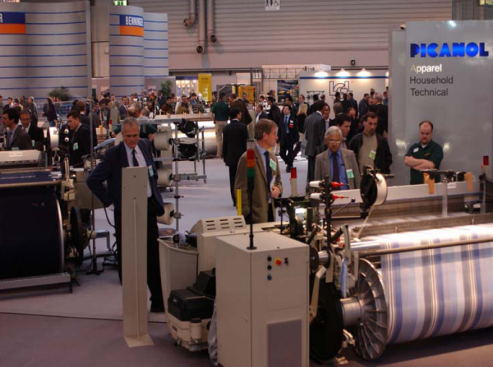
What can we achieve by taking part in an exhibition?
Sales / Orders
Create sales lead
Direct sales
Create data base
Relations with customers / PR
Create relations
Train customers
Up – sell, cross-sell
Market Research
Market test of a new product
Marketing campaign appraisal

Slide 14

What can we achieve by taking part in an exhibition?
Branding of your products
Create brand awareness
Positioning or re-positioning of a brand
Training through product display
New market share
Channel support
Find new agents or partners
for your products
Support your existing channel
of collaborators
Build an image
Media relations
Build relations with the Media and….
make some noise!

Slide 15
This is you (or your partner) totally confused
Limited budget
No exhibition
Culture / habits
Many alternatives
Product Branding
Need for total
service
Need for
professional
trade visitors

Slide 16
Why do we take part in an exhibition?
We set primary and secondary goals depending on what kind of products our company wishes to exhibit. So, we take part in an exhibition in order to:
Launch a new product, service or idea
Keep contacts with our existing customers
Create a data base of potential new customers
Meet the leaders in the field we are active in
Lobbying and networking
Achieve direct sales
Do Market research
Find new agents or distributors
Create possibilities for exports
Enter a new market
Create brand awareness
Meanwhile we should carefully examine:
Which exhibition is the most suitable for us according to the targets we have set
The company budget for taking part in exhibitions
Who are our customers – which visitors do we want to attract and satisfy

Slide 17

What do I do???
How do I choose the right exhibition???
How much money
do I have for
the exhibition?
What are my goals,
my targets ?
Who are
my customers?
Who are the new
customers I want
to find?
The proper exhibition
for my products is…

Slide 18
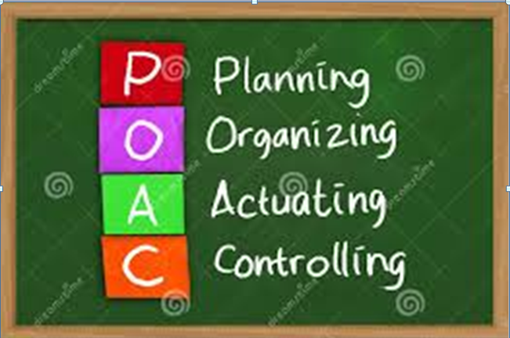
Ok. I found my Fair. What now???

Slide 19
Proper programming
Twelve months before the exhibition
Make a list of potential exhibitions and choose the right one
Request and analyze the exhibition data of the past couple of years
Prepare a draft budget
Nine months before the exhibition
Confirm your exhibition choice
Name a person in charge of your exhibition participation (stand director)
Decide on the type of stand you need and send out your application form to the organizers together with the first bank deposit if necessary
Develop specific targets for your participation
Start planning your participation in details
Check all terms and conditions as well as procedures set by the organizers
Collect all necessary data regarding your stand (exact location, neighbors etc)
Adjust your budget
Finalize your budget

Slide 20
Preparations
Six months before the exhibition
Have contacts and meetings with the persons in charge of your stand design and construction – collect ideas
Start designing your actual participation
Organize travelling and accommodation details
Collect data concerning dispatch of your samples / products
Prepare brochures and leaflets (translations).
Check your budget once more
Four months before the exhibition
Finalize your stand design
Finalize the way your samples / exhibits shall be transferred
Start promoting your actual participation in the exhibition
Re-examine your budget

Slide 21
Just before the opening…
Two months before the exhibition
Inform the organizers about your staff that shall take part in the exhibition
Send out Press Releases and advertising material
Train your stand staff
Contact the organizers once more to check if any other docs are needed
Start promo campaign of your participation
Check your budget once more
One week before the opening
Proceed with the dispatch of your samples / products and all other material for your stand
Have a meeting with your stand staff to update them
Finalize your promo and advertising campaign and re-examine your budget
Upon arrival at the Fairgrounds
Place your samples / products inside your stand
Go around the Hall and the Fairgrounds to get acquainted with the environment and the facilities
Last check of your stand
Check which of your competitors are there
Last meeting you’re your staff

Slide 22
During and after the exhibition
During every exhibition day
Organize meetings and evaluate their effectiveness.
Clean up and prepare your stand daily – face possible little crises
After the end of the exhibition
Inform your whole team about the exhibition
Check the dismantling of your stand
Check all bills, invoices and debits
Go through all business cards you have collected
Securely send all your samples / products back to your premises
Discuss with the organizers about your possible participation in the coming year
Back in the office
Follow-up : send personalized thank you letters to all the visitors of your stand
Evaluate the results of your participation and what you expect in the near future
Inter-company dissemination of all necessary information
Check once again all your new and old contacts
Read all relevant Press Releases
Prepare a report on the outcome of your participation in the exhibition
Finalize all costs - expenses

Slide 23
Let’s prepare ourselves for the Trade Fair.
Our company produces organic fruits & vegetables
Let’s choose our exhibition (use AUMA)
Our choices are:
Biofach – Vivaness (Germany)
Natura Food (Poland)
Interfood & Drink (Bulgaria)
Nordic Organic Food Fair (Sweden)
Exponatura (Turkey)
Remember: your goals – your target customers – your target market – your budget

Slide 24
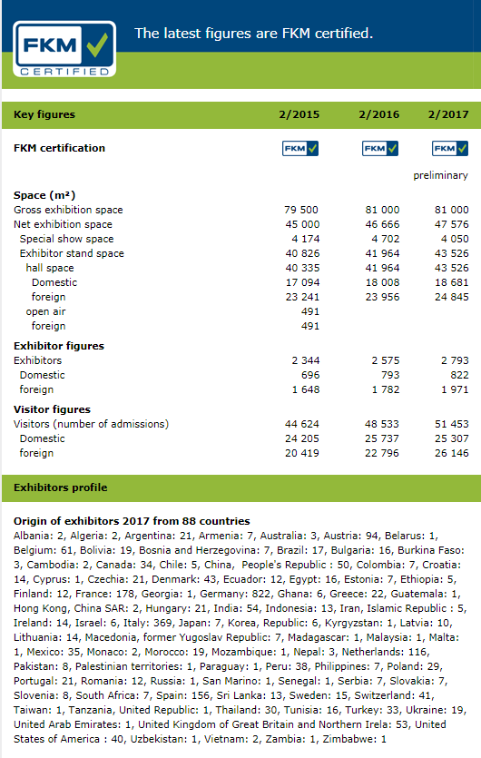
Check: 1)biggest exhibition=more visitors=more potential clients
2) Cost, 3)Past data, 4) Dates BIOFACH

Slide 25
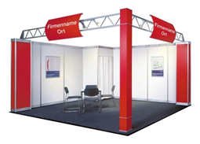
Our decision : 3000 budget, 16m2 corner stand
What extras do we need for our stand?
Do we like this stand? Are our targets met through this stand?
Is it attractive for the visitors? Should we reconsider our budget?

Slide 26
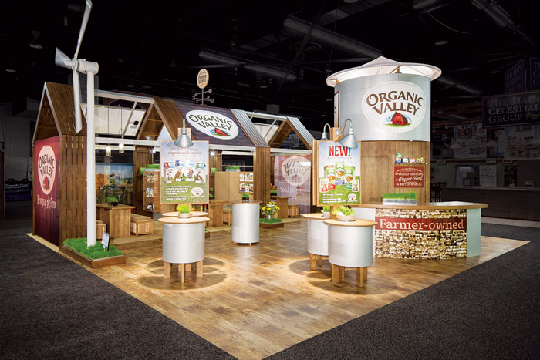
Our new decision : 5000 budget, 16-20m2 corner stand
What about this stand?

Slide 27

Or this one???

Slide 28
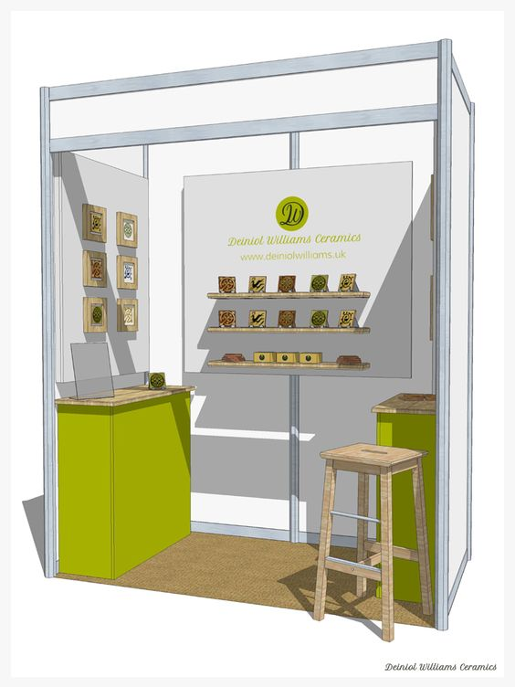
Fancy or simple booth? It doesn’t really matter !

Slide 29


Always remember to:
Look up for something new – Be innovative
Be well organized
Take “controlled” risks
Promote your business well
Respect your collaborators
Work hard

Slide 30

Neither do customers !!!
Good luck &
Thank you for your attention !

